Slide 1
ADYA
WE INTRODUCE YOU TO
Adya

Slide 2

What is Adya?
Adya means First power, Unparalleled, Great, Beyond perception, Goddess durga. Our aim is to create an online platform in order to promote and support aspiring as well as established rural women entrepreneurs. This website will allow rural women to launch a new business or connect with existing ventures and get employed.

Slide 3
Why Adya?
There is an entrepreneurial surge amongst women entrepreneurs during this pandemic and women entrepreneurs are coming forward in India but they definitely need mentoring support from experts to sustain the business. Here is where Adya plays an important role to handhold entrepreneurs in every stage of their business. Adya is an initiative to promote and support aspiring as well as established rural women entrepreneurs.

Slide 4
Message #user-interface
Message #user-interface
How?
We have created a website in order to fulfill these needs. The user interface of this website is interactive as well as convenient for users to find Indian Government schemes easily. As an aggregator platform, Adya hosts information and services relevant to women entrepreneurs. Adya enables partnerships between Rural women and existing ventures.

Slide 5
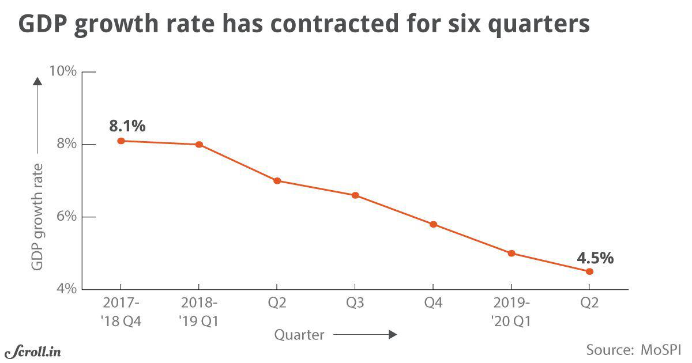

Women Empowerment
Can lead to growth in GDP rate

Slide 6
1.
We have a special page for Self Help Groups which provides them help in all aspects of business ranging from networking to accessibility.
Assistance to self help groups
2.
Here we start...
Services
Provided
Rural women can get access to all kinds of formal as well as informal sources of finance through our website.
Financial Support
3.
Our website acts as a bridge between women with different skill sets. Helps them in collaboration.
Networking

Slide 7
4.
Search for schemes
We have a special panel which displays all the current schemes provided by the government to support women entrepreneurs.
5.
Services
Provided
Job Opportunities
Our websites helps recruiters to find rural women with relevant skill sets. This helps in providing job opportunities to rural women and acts as a source of livelihood for them.
6.
Handicraft Supports
Provides the rural women a support to promote their handicraft material and convert it into a successful business.

Slide 8








Website
CSS 3
Node Js
JavaScript
Express
Bootstrap
MongoDB
Django
REACT

Slide 9
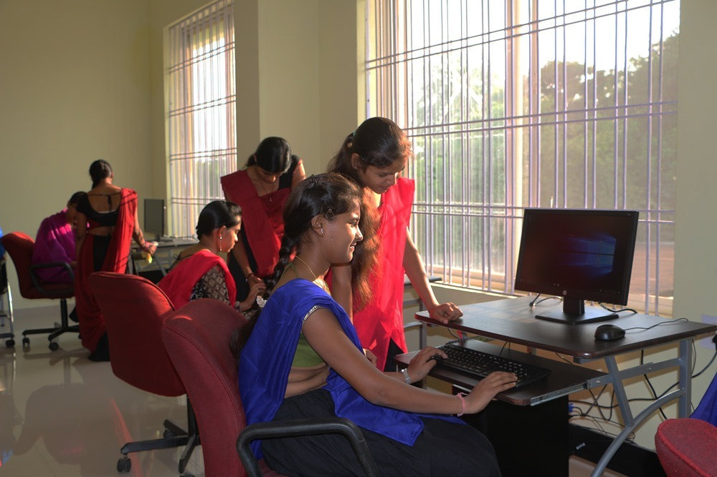
ACCESSABILITY STRATEGY FOR THE WEBISTE EASY FOR THE RURAL WOMEN
Desktops or screens will be installed at the government owned shops in towns and villages. As these shops are visited by the women very frequently, hence these would be an ideal places for the installments.
There is a possibility that the women may face difficulty while using the website initially. So to solve this problem, some women would be trained to use the websites in Anganwadi .Later these women would be there to help the other women.
Helpers would also be present to help women to use the portal.
Django

Slide 10
Responsive Design
We make sure that it will display nicely on smaller screens. Making this a priority we are providing top-notch customer service to our mobile and desktop visitors.
Features
After a lot of brainstorming, here are the idea we came up with to include in our website.
Animations (UI)
We will be including different sorts of animations to make the website more appealing and attractive.
Newsletter
We hope to inform our users about the recent additions in different categories through a newsletter.
Contact Us
Want to reach us with something innovative? We’ll be taking your ideas through this feature.
Well Planned Information Architecture
We have planned our website sections and categories carefully and presented information in a way that it is easy for users to find.

Slide 11
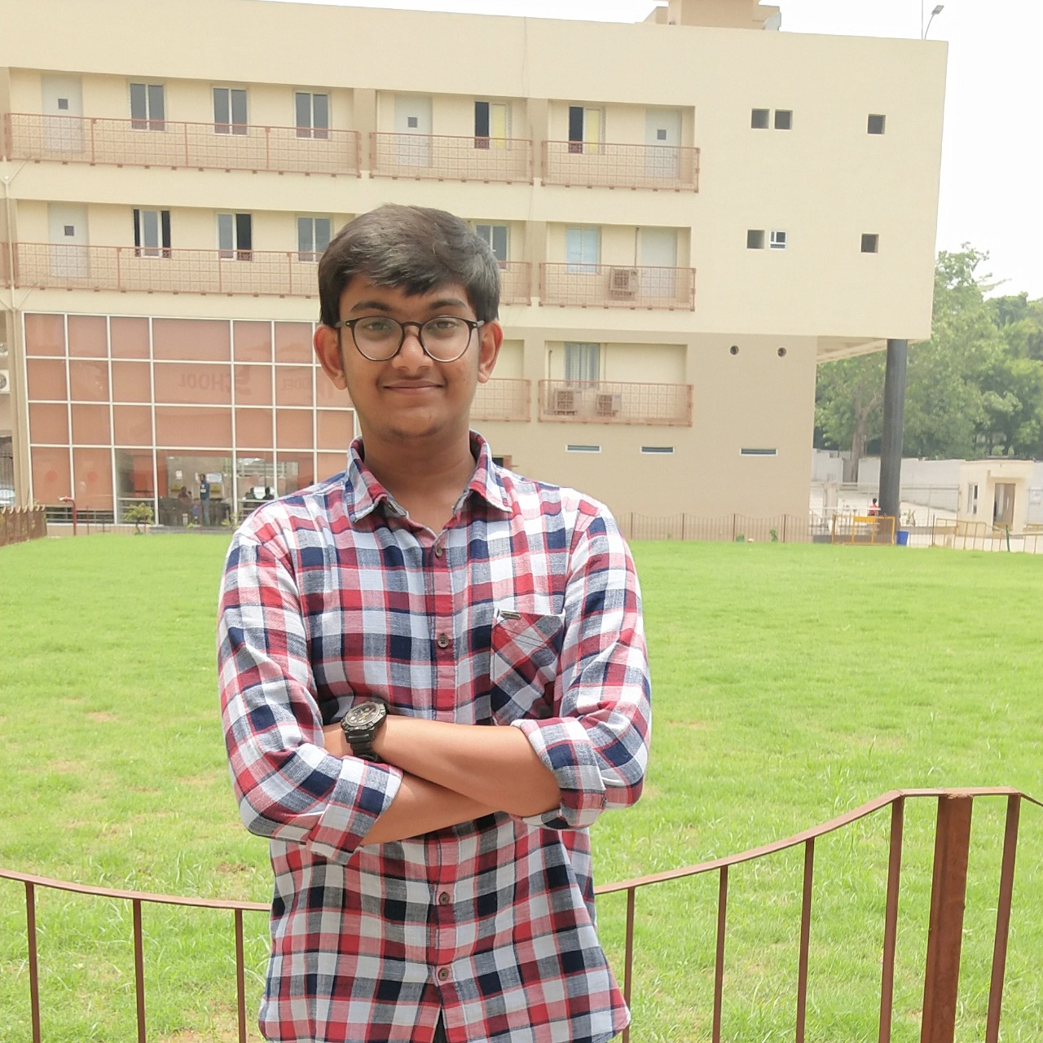
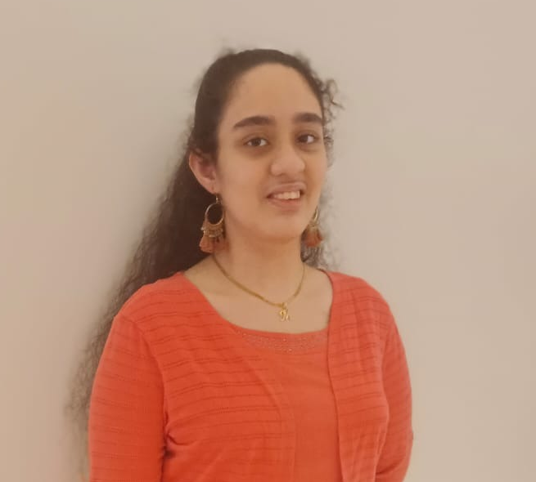
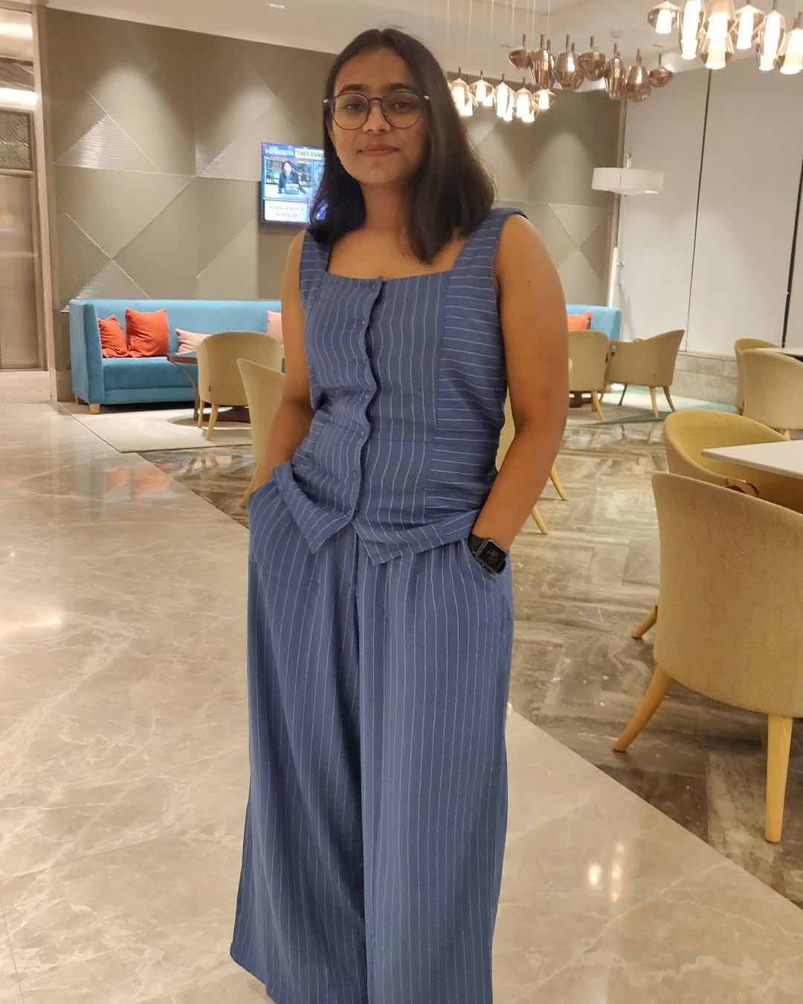
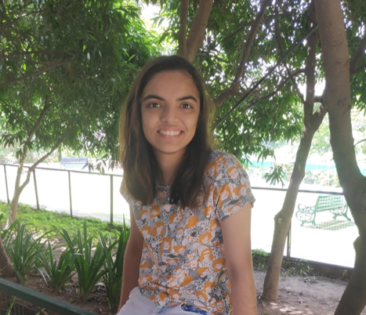

Team Members
(CODE LINGUISTICS)
Ayush Agarwal
Mansideep Kaur Gulati
Gracy Singh
Taesha Mendiratta
Prateek Rustagi

Slide 12
Thank You

